Slide 1




Lecture 9 Ms. Maham Mehr Awan
Achieving Qualities

Slide 2
USABILITY
Usability is concerned with;
how easy it is for the user to accomplish a desired task
and the kind of user support the system provides.
It can be broken down into the following areas:
Learning system features. If the user is unfamiliar with a particular system or a particular aspect of it, what can the system do to make the task of learning easier?
Using a system efficiently. What can the system do to make the user more efficient in its operation?

Slide 3
USABILITY
Minimizing the impact of errors. What can the system do so that a user error has minimal impact?
Adapting the system to user needs. How can the user (or the system itself) adapt to make the user's task easier?

Slide 4
Usability Tactics
Two types of tactics support usability, each intended for two categories of "users."
The first category, runtime, includes those that support the user during system execution.
The second category is based on the iterative nature of user interface design and supports the interface developer at design time.

Slide 5
RUNTIME TACTICS
Once a system is executing, usability is enhanced;
by giving the user feedback as to what the system is doing
and by providing the user with the ability to issue usability-based commands.
For example, cancel, undo, aggregate, to support the user in either error correction or more efficient operations.

Slide 6
RUNTIME TACTICS
Researchers in human–computer interaction have used the terms;
"user initiative," "system initiative," and "mixed initiative"
to describe which of the human–computer pair takes the initiative in performing certain actions and how the interaction proceeds.
For example,
when canceling a command the user issues a cancel—"user initiative"—and the system responds.
During the cancel, however, the system may put up a progress indicator—"system initiative."
Thus, cancel demonstrates "mixed initiative." We use this distinction between user and system initiative to discuss the tactics that the architect uses to achieve various scenarios.

Slide 7
User Initiative
When the user takes the initiative, the architect designs a response. The architect must enumerate the responsibilities of the system to respond to the user command.
To use the cancel example again:
When the user issues a cancel command, the system must be listening for it (thus, there is the responsibility to have a constant listener that is not blocked by the actions of whatever is being canceled);
any resources must be freed being used by the canceled command; and components that are collaborating with the canceled command must be informed so that they can also take appropriate action.

Slide 8
System Initiative
When the system takes the initiative, it must rely on some information;
Maintain a model—about the user,
Maintain a model—about the task being undertaken by the user,
Maintain a model—about the system state itself.

Slide 9
A model of the user
In this case, the model maintained is of the user.
It determines the user's knowledge of the system, the user's behavior in terms of expected response time, and other aspects specific to a user or a class of users.
For example, maintaining a user model allows the system to pace scrolling so that pages do not fly past faster than they can be read.

Slide 10
A model of the task
In this case, the model maintained is that of the task.
The task model is used to determine context so the system can have some idea of what the user is attempting and provide various kinds of assistance.
For example, knowing that sentences usually start with capital letters would allow an application to correct a lower-case letter in that position.

Slide 11
A model of the system
In this case, the model maintained is that of the system.
It determines the expected system behavior so that appropriate feedback can be given to the user.
The system model predicts items such as the time needed to complete current activity.

Slide 12
DESIGN-TIME TACTICS
User interfaces are typically revised frequently during the testing process.
That is, the usability engineer will give the developers revisions to the current user interface design and the developers will implement them.

Slide 13
Separate the user interface
Separate the user interface from the rest of the application.
This leads to a tactic that is a refinement of the modifiability tactic of semantic coherence.
Since the user interface is expected to change frequently both during the development and after deployment,
maintaining the user interface code separately will localize changes to it.
The software architecture patterns developed to implement this tactic and to support the modification of the user interface such as:
Model-View-Controller
Notes:
Model–view–controller (usually known as MVC) is a software design pattern^{[1]} commonly used for developing user interfaces which divides the related program logic into three interconnected elements. This is done to separate internal representations of information from the ways information is presented to and accepted from the user.^{[2][3]} Following the MVC architectural pattern decouples these major components allowing for code reuse and parallel development.

Slide 14
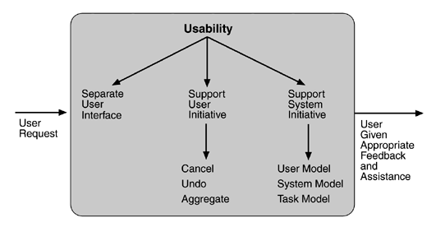
Summary of runtime usability tactics

Slide 15
TESTABILITY
Software testability refers to
the ease with which software can be made to demonstrate its faults…….when an increment of software development is completed.
In particular, testability refers to the probability, assuming that the software has at least one fault, that it will fail on its test execution.
At least 40% of the cost of developing well-engineered systems is taken up by testing.
If the software architect can reduce this cost, the payoff is large.

Slide 16
TESTABILITY
For a system to be properly testable,
it must be possible to control each component's internal state and inputs
and then to observe its outputs.
Frequently this is done through use of a test harness,
The response measures for testability deal with;
how effective the tests are in discovering faults
and how long it takes to perform the tests to some desired level of coverage.

Slide 17
TESTABILITY TACTICS
The goal of a testing is to discover faults.
This requires that input be provided to the software being tested and that the output be captured.
We discuss two categories of tactics for testing:
providing input and capturing output,
and internal monitoring.

Slide 18
INPUT/OUTPUT
There are three tactics for managing input and output for testing.
Record/playback.
Separate interface from implementation.
Specialize access routes/interfaces.

Slide 19
Record/playback.
Record/playback refers to both capturing information crossing an interface and using it as input into the test harness.
The information crossing an interface during normal operation is;
saved in some repository and represents output from one component
and input to another.
Recording this information allows test input for one of the components to be generated and test output for later comparison to be saved.

Slide 20
Separate interface from implementation.
Separating the interface from the implementation allows substitution for various testing purposes.
Stubbing implementations allows the remainder of the system to be tested in the absence of the component being stubbed.
Substituting a specialized component allows the component being replaced to act as a test harness for the remainder of the system.

Slide 21
Specialize access routes/interfaces.
Having specialized testing interfaces allows the capturing of variable values for a component through a test harness as well as independently from its normal execution.
For example, metadata might be made available through a specialized interface that a test harness would use to drive its activities.
Specialized access routes and interfaces should be kept separate from the access routes and interfaces for required functionality.

Slide 22
INTERNAL MONITORING
A component can implement tactics based on internal state to support the testing process…..Built-in monitors.
The component can maintain state, performance load, capacity, security, or other information………… accessible through an interface.
This interface can be a permanent interface of the component
or it can be introduced temporarily.
A common technique is to record events when monitoring states have been activated.
Monitoring states can actually increase the testing effort and increased visibility of the component usually more than outweigh the cost of the additional testing.

Slide 23
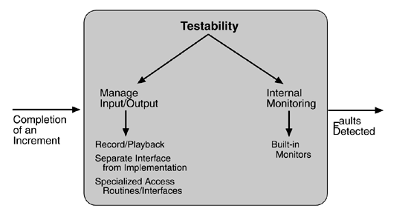
Summary of testability tactics

